Slide 1
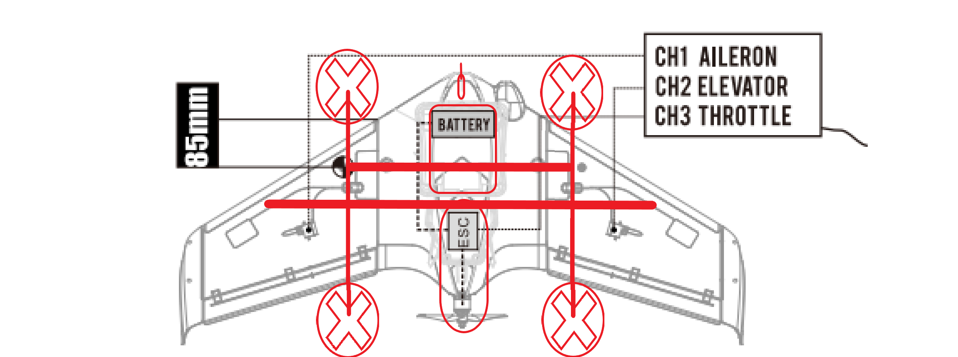
1.
2.
3.
4.
5.
6.
7.
Team Design Additions
Propeller and boom assembly
Airspeed Sensor
ModiFly Base insert
Carbon Fiber poles and boom assembly joint connection
Carbon Fiber Poles for wing stability
Forward Propulsion ESC
Forward Propulsion Propellor

Slide 2
